Slide 1



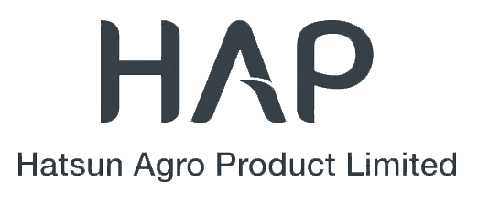
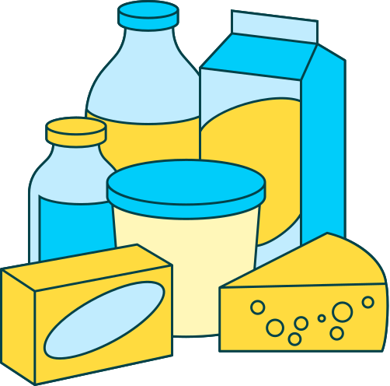

Slide 2
Digital Marketing

Slide 3
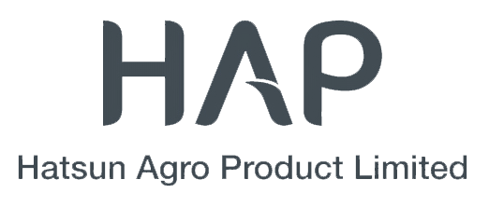









Slide 4
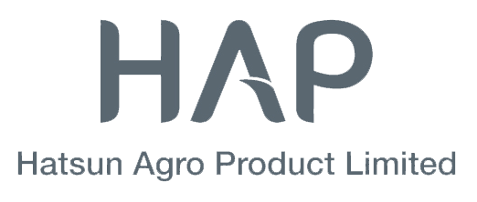
Team members
Kanithi prem kumar ( Team Lead)
Gottapu Nikhitha
Bainapalli Nagesh
Tamiri Naveen

Slide 5

Table of Contents
1.Team members
2.Introduction
3.Brand Study, Competitor Analysis & Buyer's/Audience's Persona
4.SEO & Keyword Research
5.Content Ideas And Marketing Strategies
6.NSE NIFTY
7. BSE SENSEX
8.Content Creation And Curation

Slide 6



Introduction
Hatsun Agro Products Limited is an Indian dairy company known for producing and selling milk, ice cream, and dairy-based products. Founded in 1970, it operates popular brands like Arokya Milk, Arun Ice Creams, and Hatsun Curd. The company has a strong presence in South India and exports dairy products to global markets.

Slide 7
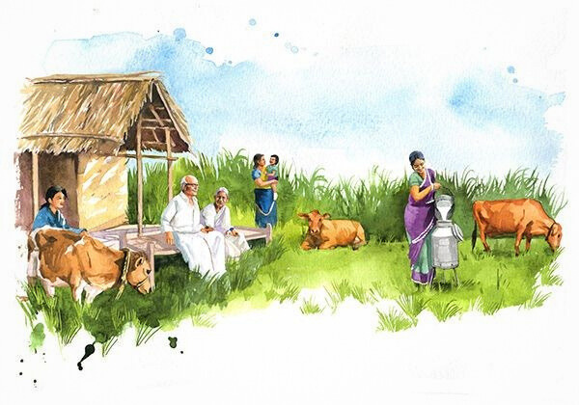
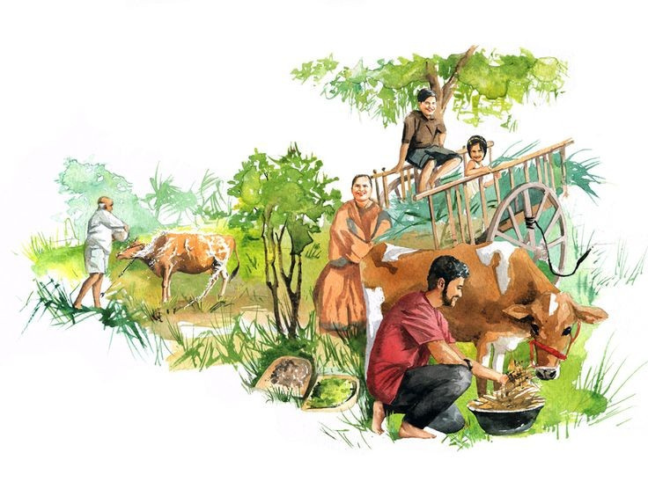

Slide 8
Brand Study, Competitor Analysis & Buyer's/Audience's Persona

Slide 9
Research Brand Identity
Hatsun Agro Product Ltd (HAP) is a leading private-sector dairy company in India, renowned for its commitment to quality and innovation.
Mission and Values:
HAP's mission is to "develop and implement a world-class Occupational Safety, Health, and Environment (OSHE) framework by leveraging leadership commitment and stakeholder engagement to create a safe, productive, and non-polluting workplace."
The company values its relationship with dairy farmers, understanding that its strength lies in consolidating its source. Development policies are always based on building a strong bond with the farmer.
Unique Selling Proposition (USP):
HAP's USP is its emphasis on maintaining good relations with its source—the dairy farmer. This approach ensures the procurement of high-quality raw materials, which translates into superior dairy products for consumers.
Brand Messaging:
HAP positions itself as a company that genuinely cares for its consumers, offering premium quality products that are healthy and nutritious. This commitment has led it to become one of the world's largest health-focused dairy providers.
Tagline:
HAP's tagline, "Nothing added. Nothing removed," reflects its dedication to purity and quality in its dairy offerings.
Through its mission, values, unique selling proposition, brand messaging, and tagline, Hatsun Agro Product Ltd consistently communicates its dedication to quality, safety, and consumer well-being.

Slide 10
Brand Messaging:
HAP positions itself as a company that genuinely cares for its consumers, offering premium quality products that are healthy and nutritious. This commitment has led it to become one of the world's largest health-focused dairy providers.
Tagline:
HAP's tagline, "Nothing added. Nothing removed," reflects its dedication to purity and quality in its dairy offerings.
Through its mission, values, unique selling proposition, brand messaging, and tagline, Hatsun Agro Product Ltd consistently communicates its dedication to quality, safety, and consumer well-being.

Slide 11

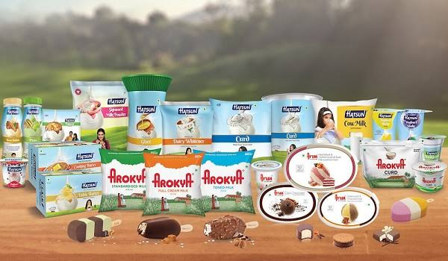

Competitor Analysis
Competitor 1: Amul (Gujarat Cooperative Milk Marketing Federation Ltd.)
Competitor 2: Mother Dairy
Competitor 3: Parag Milk Foods (Gowardhan, Go, and Topp Up brands)

Slide 12

Buyer's/Audience's Persona
1. Demographics: Middle to upper-middle-class families, young professionals, fitness enthusiasts, and B2B clients (hotels, restaurants).
2. Psychographics: Health-conscious, quality-driven, family-oriented, and fitness-focused individuals.
3. Behaviors: Regular dairy consumers, prefer trusted brands, shop at supermarkets, local stores, and online.
4. Interests: Healthy eating, organic food, fitness, traditional Indian cuisine, and sustainable dairy farming.

Slide 13
SEO & Keyword Research

Slide 14


SEO Audit for Hatsun Agro Products
1. Technical SEO: Check website speed, mobile-friendliness, crawlability, and indexability.
2. On-Page SEO: Optimize title tags, meta descriptions, headers, and keyword usage in content.
3. Off-Page SEO: Analyze backlinks, domain authority, and brand mentions across the web.
4. Content SEO: Ensure high-quality, keyword-optimized, and engaging content for target audiences.
5. Local SEO: Optimize Google My Business, local citations, and location-based keywords.
6. User Experience (UX): Improve site navigation, readability, and overall user engagement.

Slide 15
Keyword Research
1. Primary Keywords: Focus on high-search-volume terms like best milk brand in India, buy fresh dairy products, and pure cow milk online.
2. Local SEO Keywords: Target location-based searches such as fresh milk delivery in Chennai or best dairy brand in South India.
3. Long-Tail Keywords: Use intent-driven phrases like nutritional benefits of fresh milk or where to buy pure desi ghee online for better conversions.

Slide 16
On page Optimisation
1. Title Tags, Meta Descriptions & Headers: Use relevant keywords like Best Dairy Products in India with structured H1, H2, and H3 tags.
2. Content & URL Optimization: Ensure high-quality, keyword-rich content, short SEO-friendly URLs, and internal linking for better navigation.
3. Technical SEO: Optimize images (alt text), improve mobile-friendliness, and implement schema markup for enhanced search visibility.

Slide 17
Content Ideas And Marketing Strategies

Slide 18

Content Idea Generation & Strategy
Audience-Centric Approach: Identify customer needs and pain points (e.g., health benefits of dairy, choosing the best milk).
SEO & Trend Analysis: Use keyword research and trending topics (e.g., organic dairy, protein-rich milk, lactose-free options).
Content Diversification: Create blogs, videos, infographics, and FAQs to engage different audience segments across platforms.

Slide 19
Marketing Strategy
1. Digital Marketing: Leverage SEO, social media, and influencer collaborations to boost brand awareness and online sales.
2. Retail & Distribution Expansion: Strengthen presence in supermarkets, local stores, and e-commerce platforms for wider reach.
3. Customer Engagement: Run loyalty programs, targeted ads, and regional campaigns to enhance brand connection and repeat purchases.

Slide 20
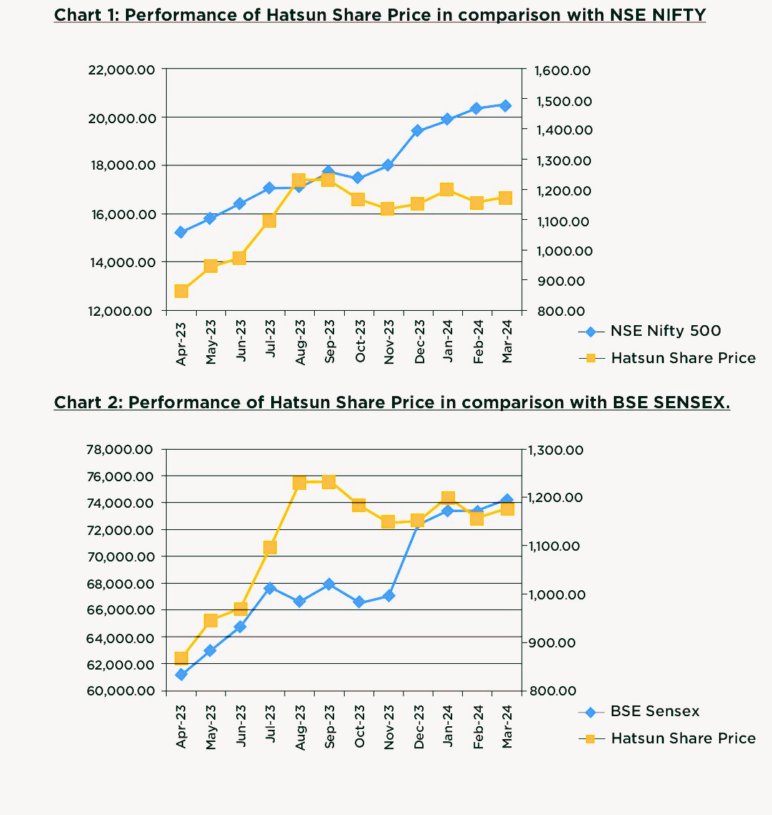

Slide 22
Content Creation And Curation

Slide 23
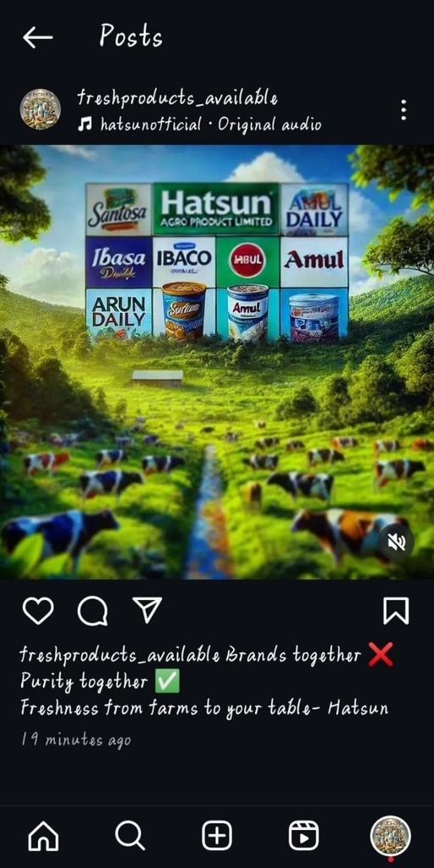
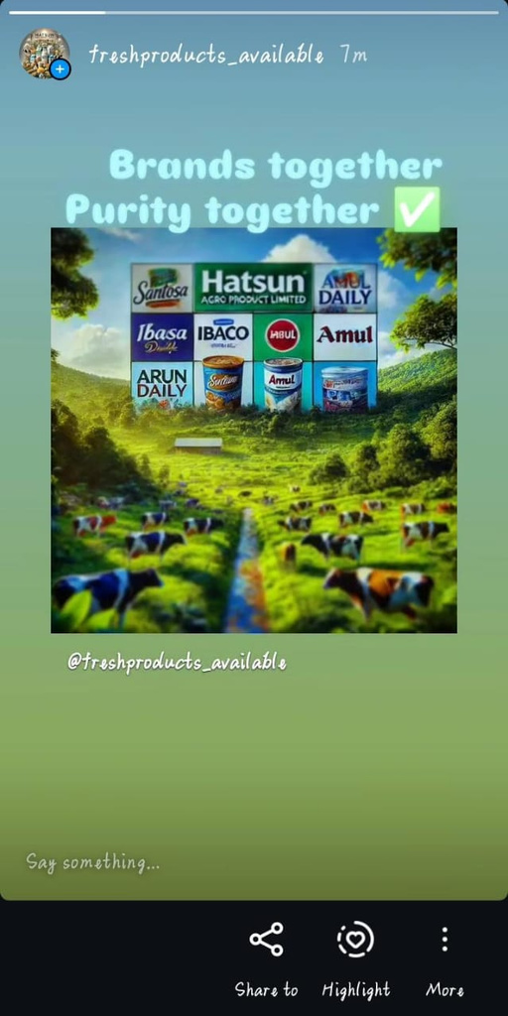

Post Creation

Slide 24
Social media ad campaigns
1. Targeted Ads: Run Facebook and Instagram ads focusing on health-conscious consumers and families looking for quality dairy products.
2. Engaging Creatives: Use high-quality visuals, carousel ads, and short videos highlighting product benefits (e.g., "Pure, Fresh, and Healthy Milk for Your Family!").
3. Call-to-Action (CTA): Drive conversions with CTAs like "Shop Now," "Order Fresh Dairy," or "Subscribe for Daily Milk Delivery."

Slide 25
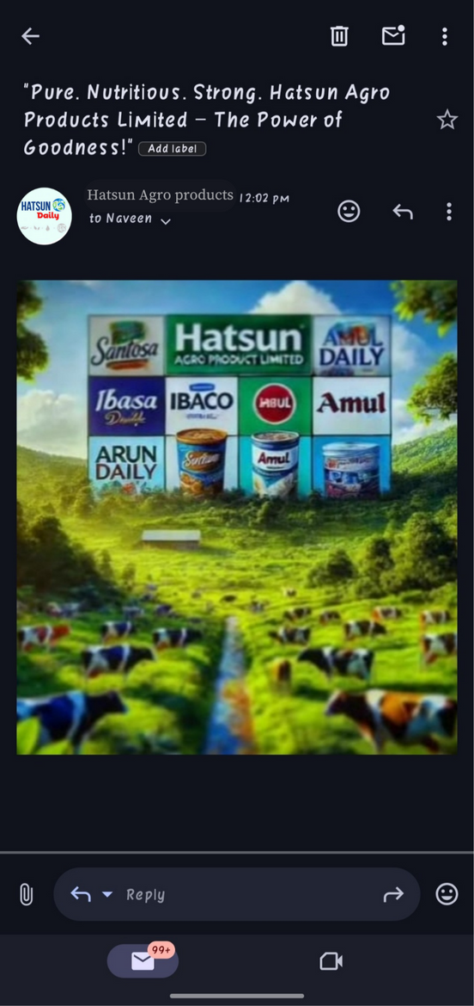

E-mail Ad Campaigns

Slide 26
Conclusion
Hatsun Agro continues to strengthen its position as a market leader in the dairy industry by focusing on quality, innovation, and sustainability. Its investment in technology, infrastructure, and farmer partnerships ensures a steady supply of high-quality dairy products. With growing consumer demand for dairy and value-added products, the company is well-positioned for sustained growth in both domestic and international markets.

Slide 27
Thank you

